Slide 1
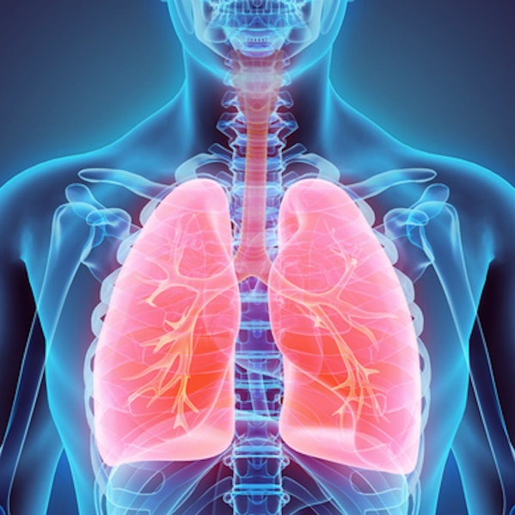
HUMAN ORGAN SYSTEMS AND BIO DESIGNS - 2
Lungs as purification systems (architecture, gas exchange mechanisms)

Slide 2
Lung Architecture
The lungs are the major organs of the respiratory system, which helps provide the body with a continuous supply of oxygen.
The main role of lungs’ is to bring in air from the atmosphere and pass oxygen into the bloodstream. From there, it circulates to the rest of the body.
The organs require help from surrounding structures in the body in order to breathe properly.
Respiration – Also known as cellular respiration, is the energy releasing reaction that takes place inside of cells. Oxygen combines with sugar to release energy.

Slide 3
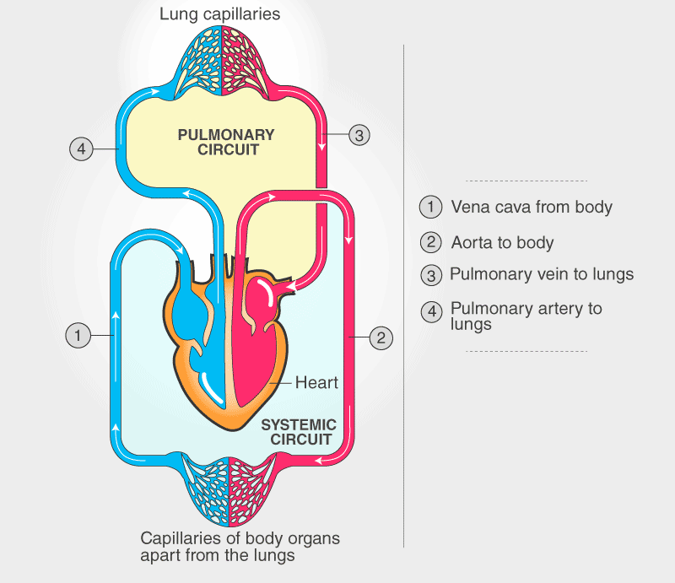
Whole Circulation

Slide 4
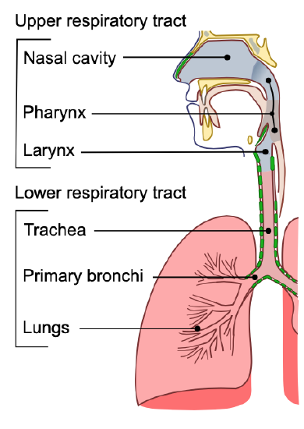
The organs of the respiratory system form a continuous system of passages called the respiratory tract , through which air flows into and out of the body.
The respiratory tract has two major divisions: the upper respiratory tract and the lower respiratory tract.
In addition to these organs, certain muscles of the thorax (the body cavity that fills the chest) are also involved in respiration by enabling breathing.
Most important is a large muscle called the diaphragm, which lies below the lungs and separates the thorax from the abdomen.
Smaller muscles between the ribs also play a role in breathing.

Slide 5
The Path of Air in the Body
Air inside the body after inhalation moves across
Upper respiratory tract and lower respiratory tract
Upper Respiratory Tract
1. Nose or Mouth – moistens and heats the air before going into the trachea.
Cilia and mucus trap dirt in the air.
2. Larynx – part of the trachea where our vocal cords are located.

Slide 6
Lower Respiratory Tract
1. Trachea – the tube that leads from the nose and mouth to the lungs.
The walls have rings of cartilage to protect the trachea and prevent it from collapsing.

Slide 7
2. Bronchi – the trachea splits into right and left bronchi, each one leading into your right and left lung.
Each bronchus (singular) leads air into the lungs and divides into smaller and smaller tubes, like a tree trunk divides into smaller and smaller branches.
3. Alveoli – grape-like structures at the end of the bronchi. This is where our blood picks up the oxygen we need.
4. Diaphragm – a large dome-shaped muscle, just under the lungs, that moves to inflate the lungs with air.

Slide 8
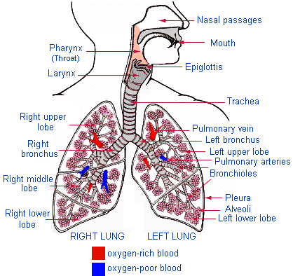
The Path Air Takes In The Body

Slide 9
Large Surface Area
The alveoli greatly increase the surface area of our lungs. If they were cut open and spread out evenly, the alveoli would cover an area the size of a tennis court!
Capillaries, very tiny blood vessels, surround each alveoli cluster so the blood can pick up large amounts of oxygen.

Slide 10
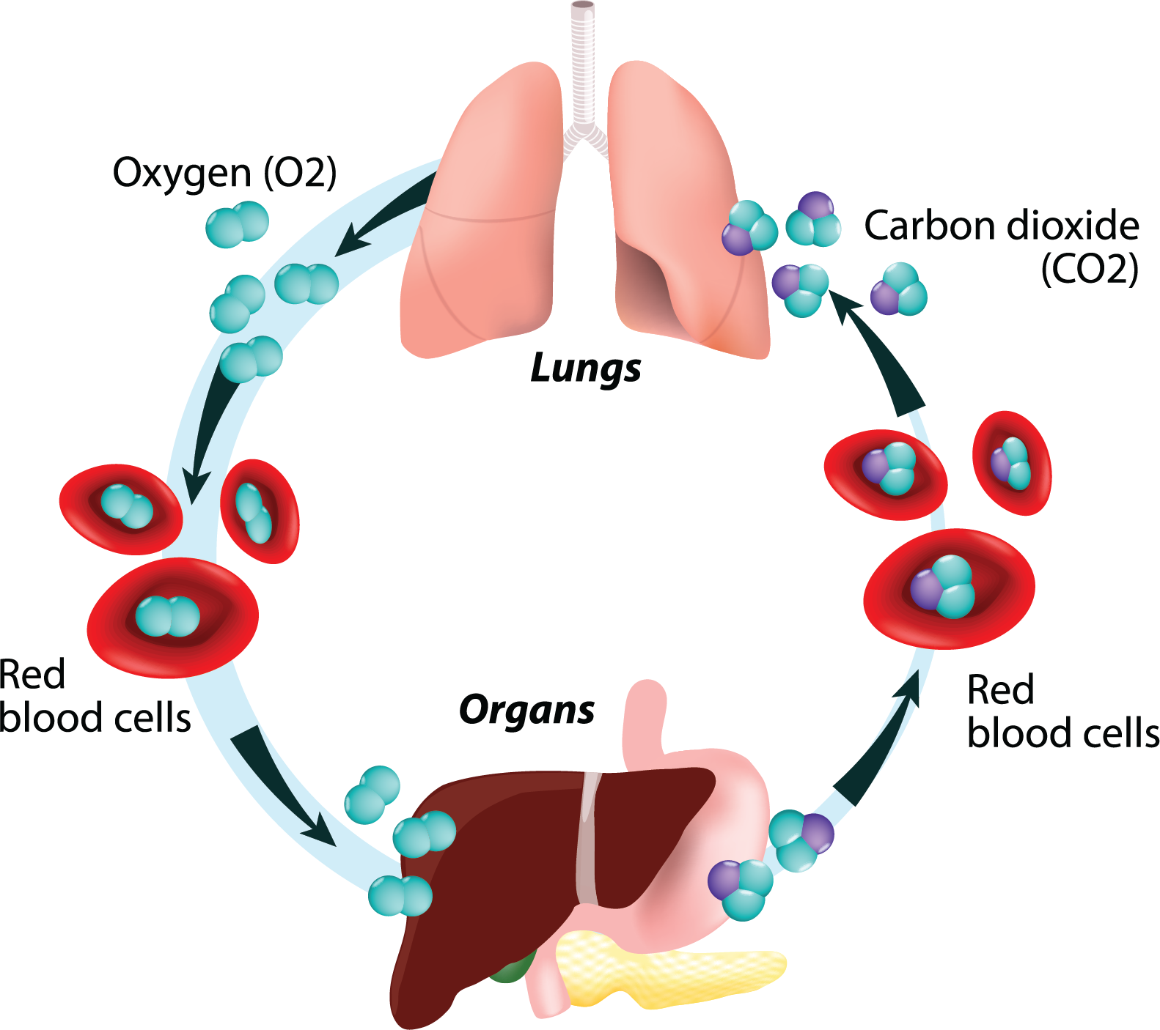
Gas exchange

Slide 11
Gas Exchange mechanism in lungs
In gas exchange process, oxygen is in and carbon dioxide is out.
The gas exchange occurs in the lungs between alveolar air and blood of the pulmonary capillaries.
Lungs contains millions of alveoli shows maximum surface area. For efficient gas exchange to occur alveoli must be ventilated and highly perfused ( Permeable) .
Ventilation (V) applied to flow of air into and out of the alveoli, while perfusion (Q) refers to flow of blood to alveolar capillaries.

Slide 12
Gas exchange : Conti--
Individual alveoli have variable degree of ventilation and perfusion in the different regions of the lungs.
Overall changes in ventilation and perfusion in the lungs are measured by the ration of ventilation to perfusion (V/Q) .
Changes in V/Q ratio can affect gas exchange may result in low oxygen .
Gas exchange in the alveoli occurs primarily by diffusion. Passing of gas from the alveoli to capillary blood, it must must pass through alveolar surfactant, other structure

Slide 13
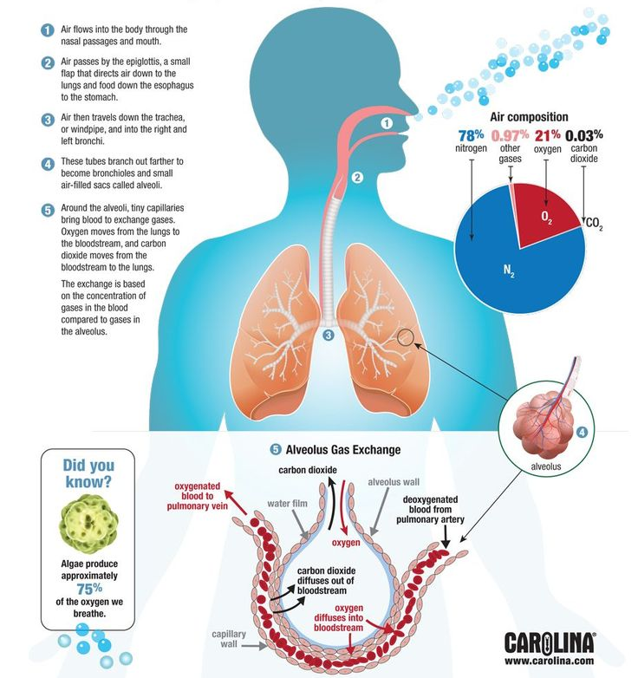

Slide 14
Disease Related to Lungs
Asthma is a long-term inflammatory disease of the airways of the lungs. It is characterized by variable and recurring symptoms, reversible airflow obstruction, and easily triggered bronchospasms.
Symptoms include episodes of wheezing, coughing, chest tightness, and shortness of breath.
Bronchitis is inflammation of the bronchi (large and medium-sized airways) in the lungs that causes coughing.
Bronchitis usually begins as an infection in the nose, ears, throat, or sinuses. The infection then makes its way down to the bronchi.
Emphysema is a lung condition that causes shortness of breath. In people with emphysema, the air sacs in the lungs (alveoli) are damaged.

Slide 15
COPD
It is a chronic inflammatory lung disease that causes obstructed airflow from the lungs.
Symptoms include breathing difficulty, cough, mucus (sputum) production and wheezing.
It's typically caused by long-term exposure to irritating gases. People with COPD are at increased risk of developing heart disease, lung cancer.

Slide 16
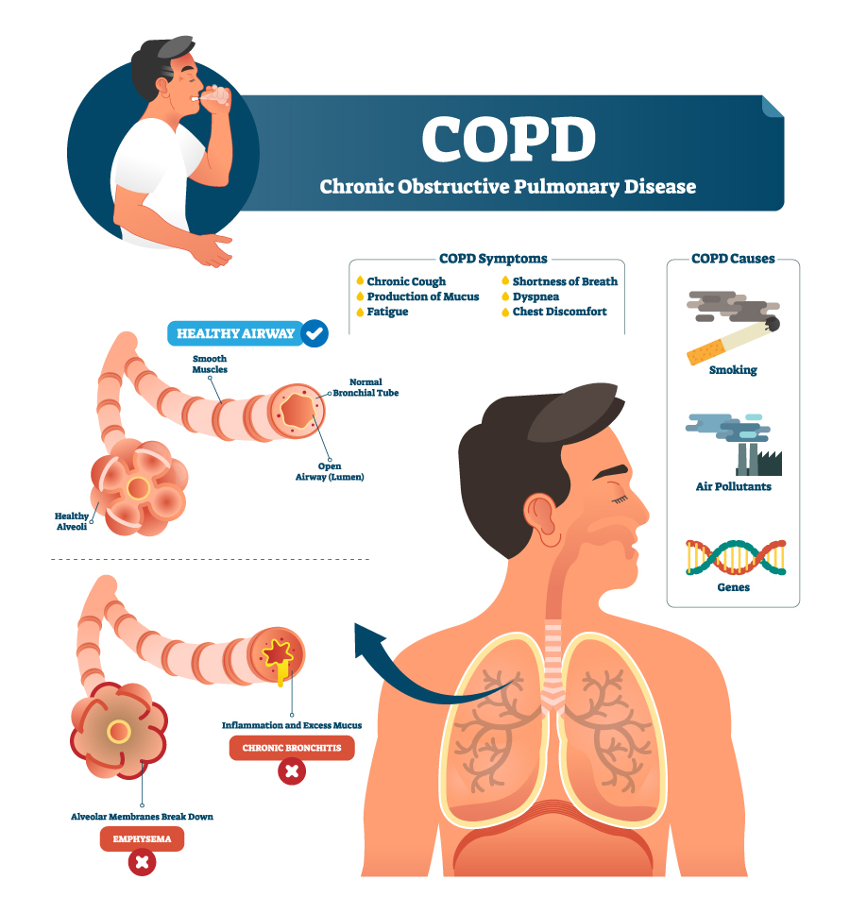
Chronic inflammatory lung disease that causes obstructed airflow from the lungs.
Symptoms include breathing difficulty, cough, mucus (sputum) production and wheezing.
It's typically caused by long-term exposure to irritating gases or particulate matter, most often from cigarette smoke.
COPD
COPD requirement: Oxygen at 24% (via a Venturi mask) at 2-3 L/minute or at 28% (via Venturi mask, 4 L/minute) or nasal cannula at 1-2 L/minute. = oxygen saturation 88-92%

Slide 17
Lung Function Tests
Lung function tests, also known as pulmonary function tests, check how well the lungs work and can help investigate breathing problems and diagnose lung conditions.
Examples of lung function tests
Spirometry: This test measures how much and how quickly people can move air in and out of their lungs.
Plethysmography: Also known as a lung volume test, this measures the amount of air individuals can hold in the lungs and how much air remains after breathing out.
Gas diffusion test: This test can measure gases, such as oxygen, moving from the lungs to the bloodstream.
Exercise stress test: This test typically involves a bike or treadmill to investigate how exercise affects lung function.

Slide 18
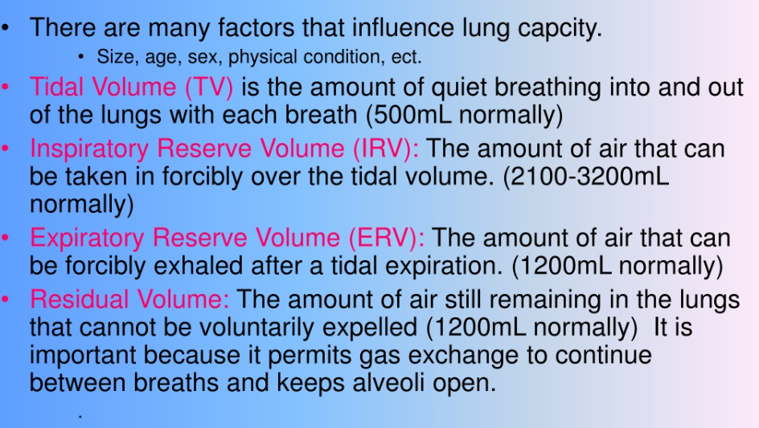
Respiratory volume

Slide 19
Lung Capacities
Tidal Volume It is the volume of air inhaled or exhaled from the lungs in normal breathing and symbolically represented as TV
Inspiratory capacity(IC)
It is the maximum volume of air (By force) that can be inhaled following a resting state. Hence it can be measured by the sum of inspiratory reserve volume and tidal volume
Vital Capacity(VC)
It is the total amount of air exhaled after maximal inhalation. It is the value corresponding to 4800 or 4.8 Lt .
it can be calculated by the sum of tidal volume, inspiratory reserve volume, and expiratory reserve volume. VC = TV+IRV+ERV.

Slide 20
Total Lung Capacity(TLC)
It is the maximum volume of air the lungs can accommodate or sum of all volume compartments or volume of air in lungs after maximum inspiration.
The normal value is about 6,000mL (4‐6 L). TLC is calculated by summation of the four primary lung volumes (TV, IRV, ERV, RV).

Slide 21
Lungs as purification systems (spirometry, abnormal lung physiology - COPD, Ventilators, Heart-lung machine)

Slide 22
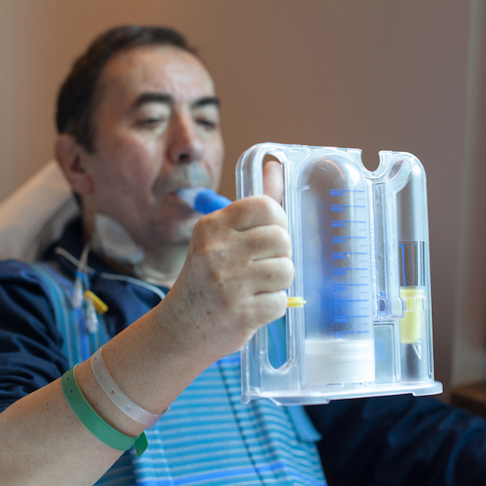
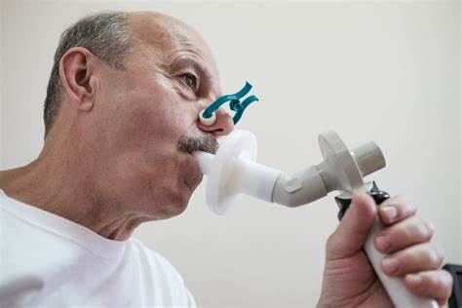
Spirometry
Spirometry (meaning the measuring of breath) is the most common of the pulmonary function tests (PFTs).
It measures lung function, specifically the amount (volume) and/or speed (flow) of air that can be inhaled and exhaled.
Spirometry is helpful in assessing breathing patterns that identify conditions such as asthma, pulmonary fibrosis, cystic fibrosis, and COPD.

Slide 23
Spirometer is a mechanical hand-held breathing device in which the patient is instructed to take slow deep breaths through the device’s mouthpiece
The device gives the patient visual feedback on the volume of the inhalation.
Incentive spirometers are available either by measuring the volume of inspiration (volume-oriented devices) or measuring the flow rate (flow-oriented devices).

Slide 24
A standard flow-oriented incentive spirometer consists of three chambers in a row.
The patient inhales through a mouthpiece connected to the unit with the three chambers.
Each chamber contains a ball that has printed on the outside of the chamber the least amount of flow needed to raise the ball.

Slide 25
With an airflow rate of 600 to 1200 milliliters (mL) per second, the deep breath lifts the balls.
When all three balls reach the top of the unit, the patient has reached a flow speed of 1200 mL/second.
The colored balls indirectly give the patient a visual indication of the inhaled volume.
The visual feedback works to improve compliance in performing the slow, sustained deep inspiration.

Slide 26
Procedure in Spirometry
Generally, patients are required to take deepest breathe and then exhaled into the sensors as long as possible for 6 seconds and some times followed by rapid inspiration.
The tests are also carried out by a span of breathing in and out from the sensor (tidal volume), or the rapid breath in (forced inspiratory part) will come before the forced expiration.
One of the preliminary spirometer measurement is forced vital capacity (FVC)
FCV is the total amount of air forcefully breathe out after breathing deeply.
Normal or abnormal values are evaluated
The procedure of spirometry has 3 phases: 1) maximal inspiration; 2) a “blast” of exhalation; 3) continued complete exhalation to the end of the test

Slide 27
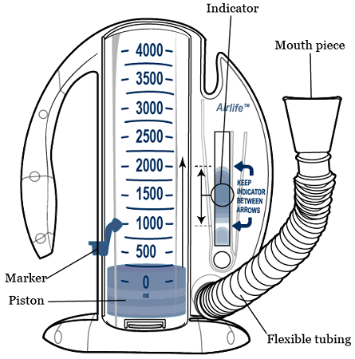
Volume oriented Spirometer
Volume measurement spirometer: Wet spirometer measure volume directly and are accurate for measuring forced expiratory volume (FEV) and vital capacity (VC).
They are simple without any electronic accessory and values are measured directly but have limited range of parameters

Slide 28
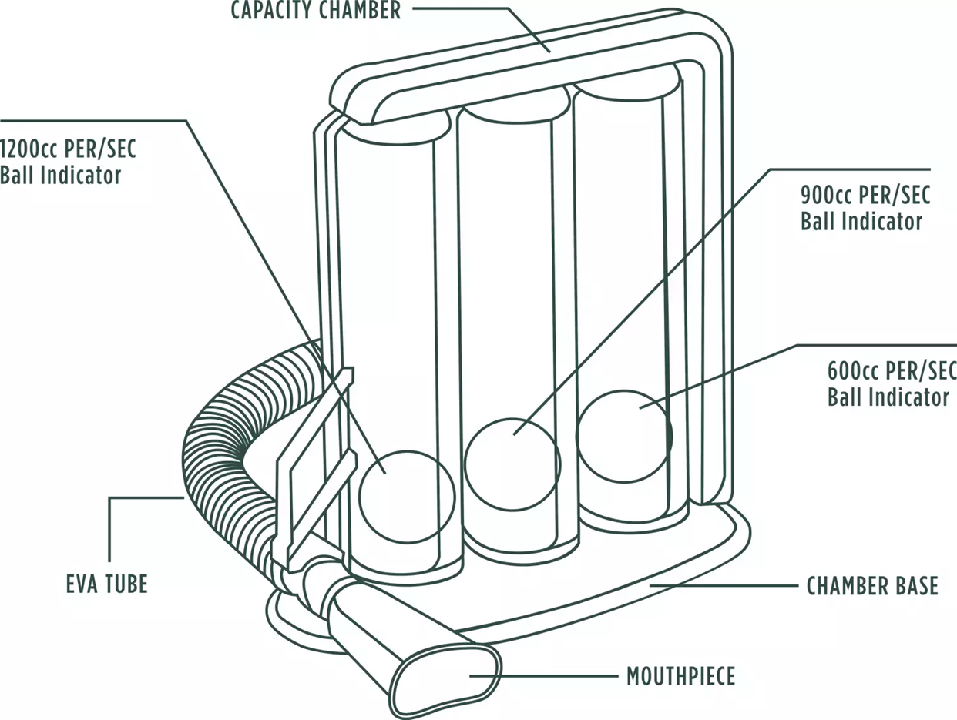
Flow oriented spirometer
Flow measurement spirometer: The most widely used in pulmonary function testing lab is the pneumatograph spirometer.
In this pressure drop over resistance is measured.
The pressure drop divided by the resistance of the pneumotachograph yields the flow, which can be transformed into a volume by time integration

Slide 29
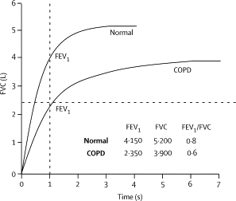

Slide 30
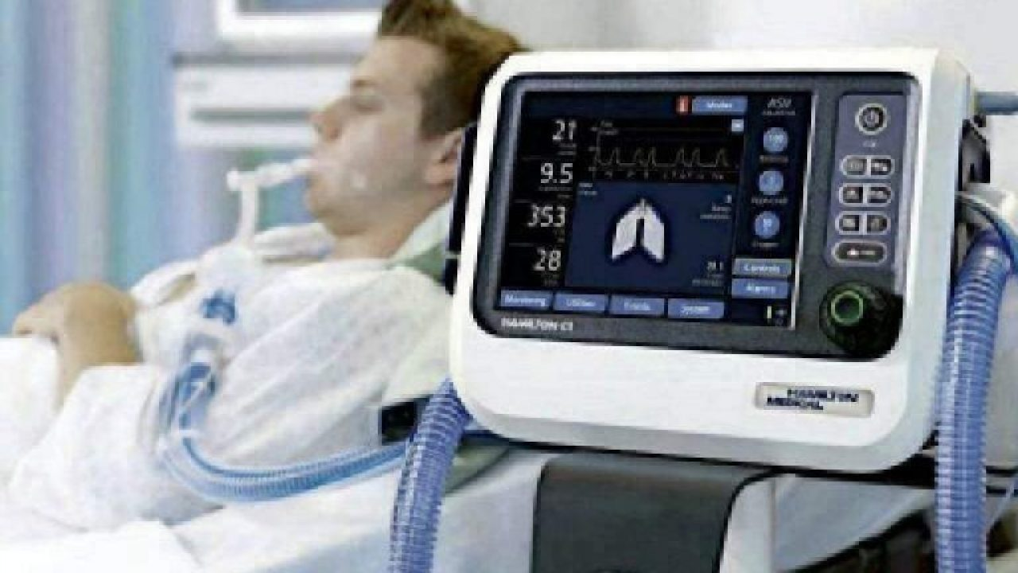
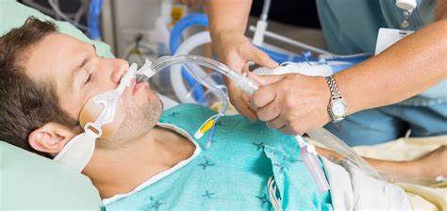
Ventilators
A ventilator is a machine that provides mechanical ventilation by moving breathable air into and out of the lungs, to deliver breaths to a patient who is physically unable to breathe, or breathing insufficiently.
Ventilators are computerized microprocessor-controlled machines, but patients can also be ventilated with a simple, hand-operated bag valve mask.

Slide 31
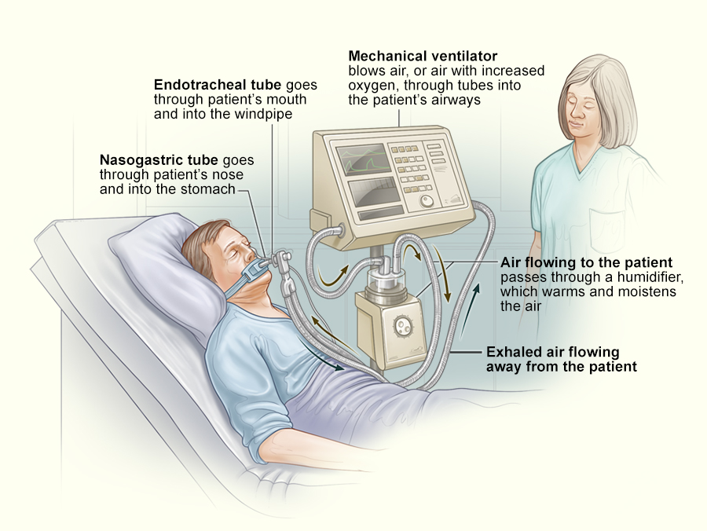

Slide 32
Working mechanism of Ventilator
During ventilation process, insertion of endotracheal tube (ET tube) through the patient’s nose or mouth and into their windpipe (trachea).
The ET tube is then connected to the ventilator.
Both ET and ventilators prform various functions.
The ventilator pushes a mixture of air and oxygen into the patient’s lungs to get oxygen into the body.
The ventilator can also hold a constant amount of low pressure, called positive end-expiratory pressure (PEEP), in order to keep the air sacs in the lung from collapsing.
Oxygen saturates are constantly monitored.

Slide 33
Respiratory tract infections
Infections can occur at any point in the respiratory tract. Some examples include:
Upper respiratory tract infection (URTI): The most frequent URTI is the common cold. Others include laryngitis, pharyngitis, and tonsillitis.
Lower respiratory tract infection (LRTI): The most common type is bacterial infection, especially bacterial pneumonia. Other causes of LRTI include viruses and fungi.
Lung cancer
Pleural cavity diseases
The pleural cavity is the gap between the inner and outer pleural membranes that encase the outside of the lungs. Pleural effusion describes a build-up of fluid in the pleural cavity.
Pulmonary vascular disease
Pulmonary vascular diseases affect the vessels that carry blood through the lungs.
Clot, fluid-leakage, excess pressure build up.

Slide 34
Heart-lung machine
In 1931, American surgeon John H. Gibbon, Jr. (1903–1974) decided to build a heart-lung machine after a young female patient died of blocked lung circulation.
The heart-lung machine (HLM) is a device used to provide blood circulation and oxygenation while the heart is stopped.
It is a means of keeping a patient alive while his/her heart is stopped or even removed from the body.
Usually called the heart-lung machine, the device also is referred to as cardiopulmonary bypass, indicating its function as a means to substitute for the normal functions of the heart (cardio) and lungs (pulmonary).
It is the function of the heart to provide circulation of blood at all times.
It pushes blood out into the body and through the lungs. It must function every minute of every day of life to maintain the health of the tissues throughout the body.

Slide 35
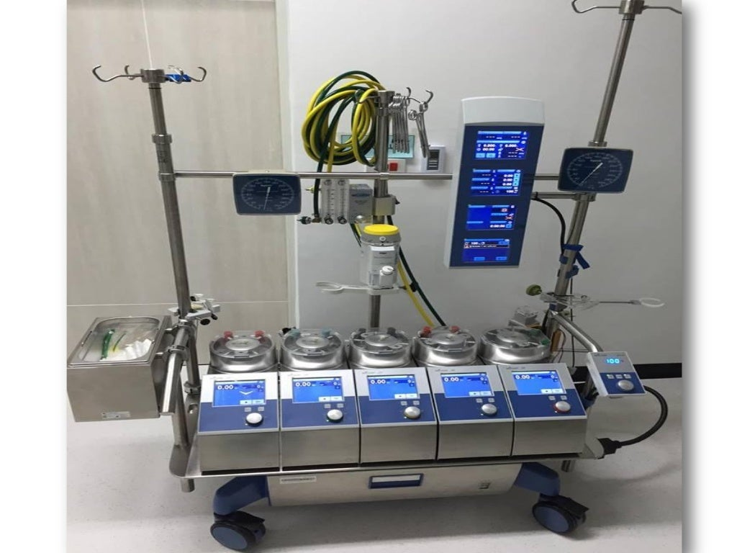
Heart-lung machine
A heart-lung machine is a equipment that temporarily takes over the work of the heart and/or lungs, providing blood and oxygen to the body.
Also called a cardiopulmonary bypass machine (CBM) or a heart-lung bypass machine, it is most often used during serious procedures that require the heart to be stopped.
Patients are kept on a heart-lung machine for only as long as it takes to stop the heart from beating, complete open-heart surgery or a procedure on the lungs, and restart the heart

Slide 36
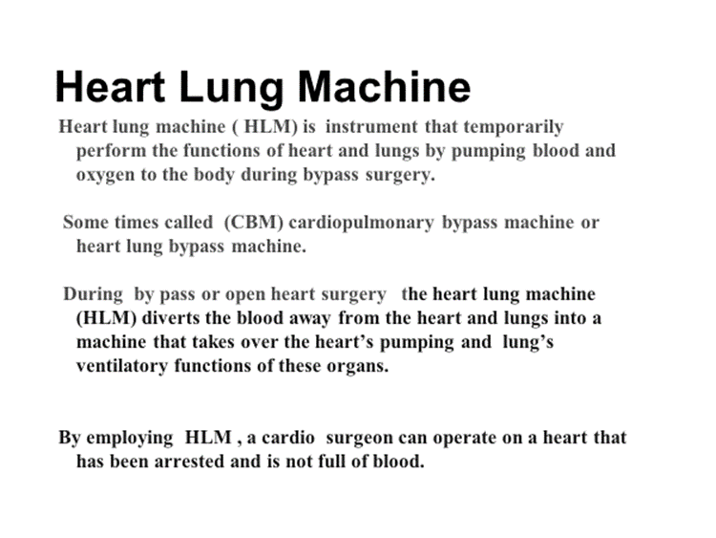

Slide 37
The Heart Lung Machine employs gravity to divert oxygen-poor blood from the right atrium ( upper chamber of heart) into a reservoir also Known as cardiaotomy reservoir. Blood is filtered for any clots.
The blood is then pumped through an oxygenator which is normally performs function of the right ventricle ( lower chamber of heart) , which removes carbon dioxide and pump oxygen (normally the function of the lungs).
In addition, one more pump of HLM pump oxygenated blood back into the body. Which are the normal functions of the left side of the heart.
Hence totally bypassing heart and lungs hence it is known as bypass surgery

Slide 38
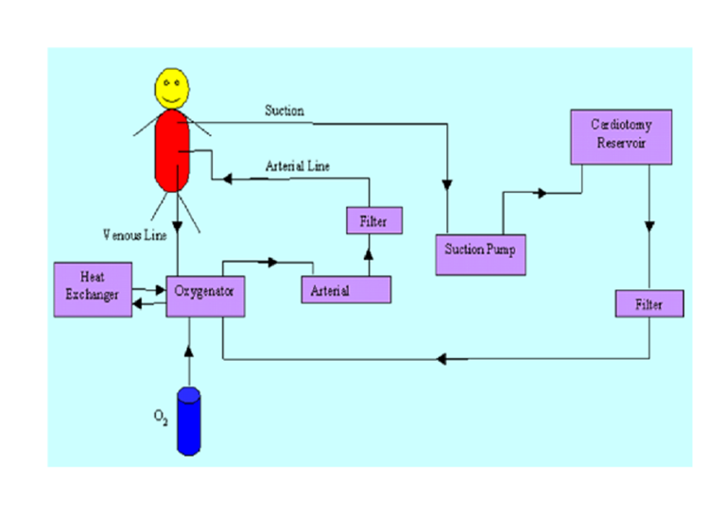
Flow Diagram of HLM

Slide 39
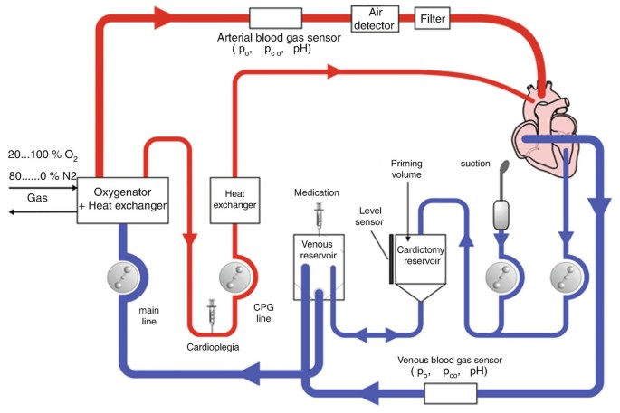
Heart Machine Lung

Slide 40
